Slide 1
SALES STRATEGY ANALYSIS FOR NEW PRODUCT LINE
Presented By : TEAM STRAIGHT B-TECH

Slide 2
OBJECTIVE
Evaluate the effectiveness of three different sales methods (Email, Call, Email + Call) to optimize sales strategy
BUSINESS GOALS:
Increase revenue from the new product line.
Improve efficiency of sales efforts.
Identify the most effective sales method.

Slide 3
DATA VALIDATION
Inconsistent Sales Method Name
Standardized Sales Method Categories
CHALLENGES
SOLUTIONS
Missing Revenue Values(1,074 missing )
Replaced Missing Revenue Values With Method-wise Mean Revenue.

Slide 4
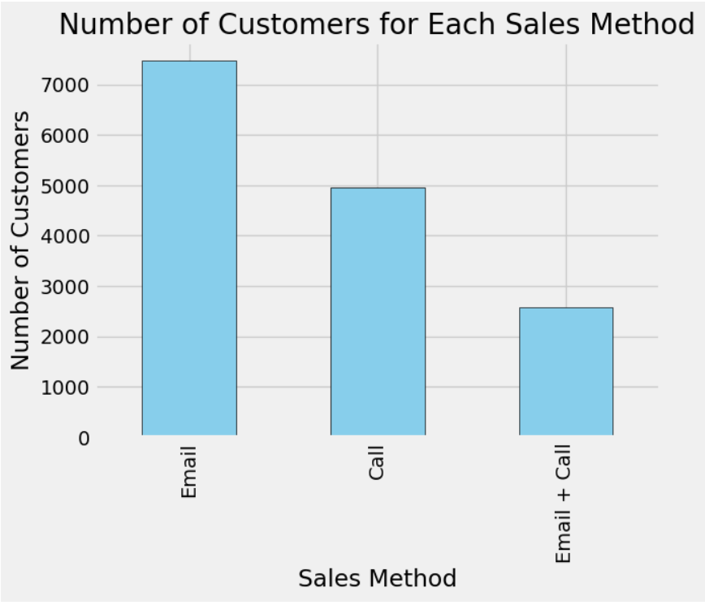
CUSTOMER DISTRIBUTION BY SALES METHOD
Number of Customers per Sales Method:
Email: 7,466 customers
Call: 4,962 customers
Email + Call: 2,572 customers 📌 Insight: Email is the most used method, but does it generate the most revenue?

Slide 5
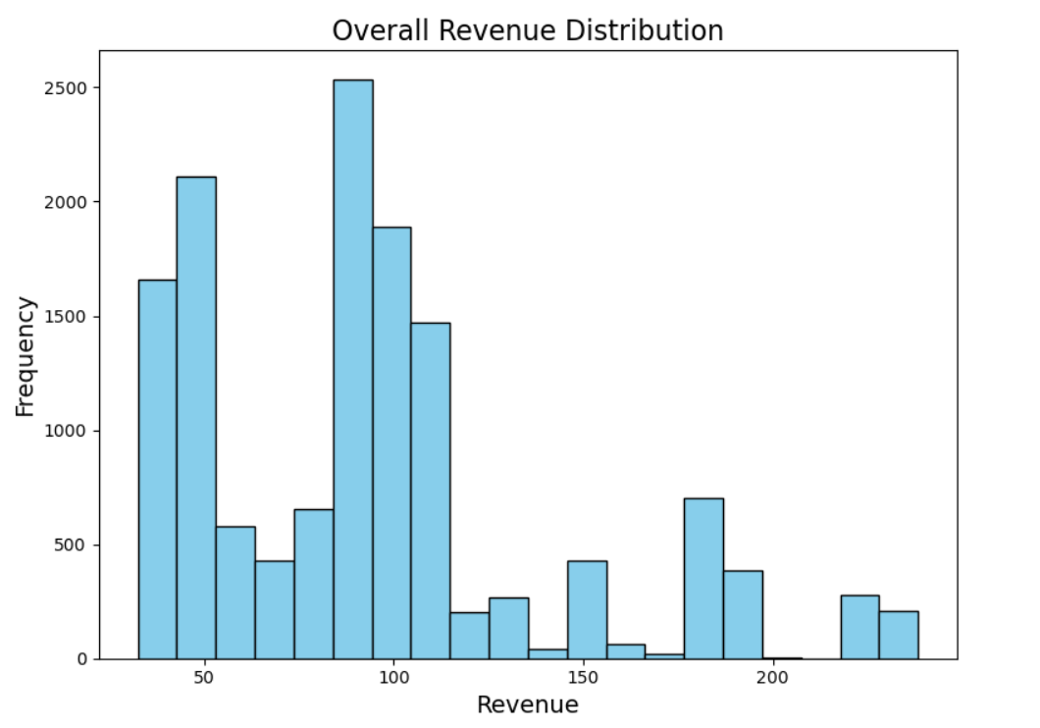
Revenue Distribution:
Email generates the most transactions but has lower revenue per customer.
Calls generate higher revenue per customer but require more effort.
Email + Call is a balanced approach. Visualization: Histogram of revenue distribution across sales methods.

Slide 6
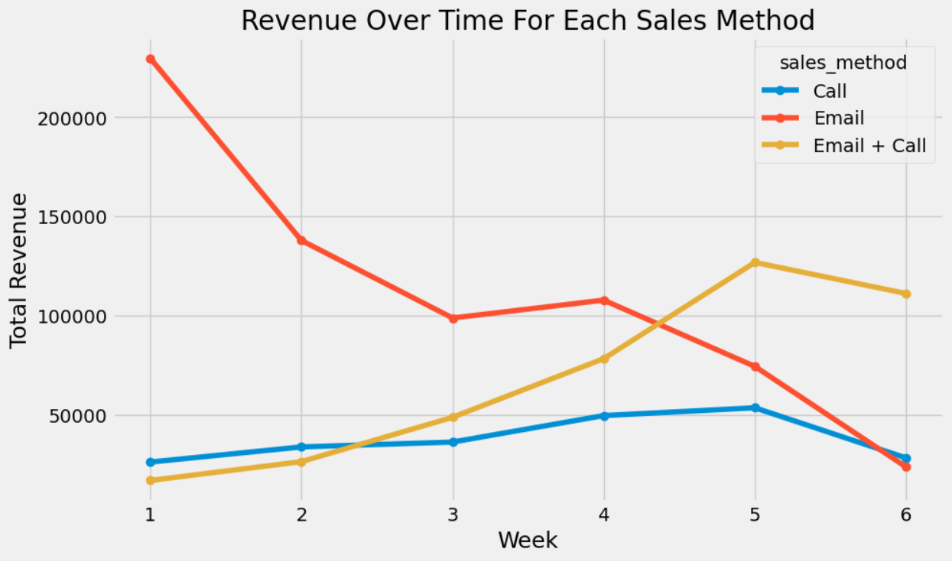
Key Finding:
Call method shows consistent revenue growth over time.
Email method fluctuates but maintains a steady volume.
Email + Call sees revenue spikes in certain weeks.

Slide 7
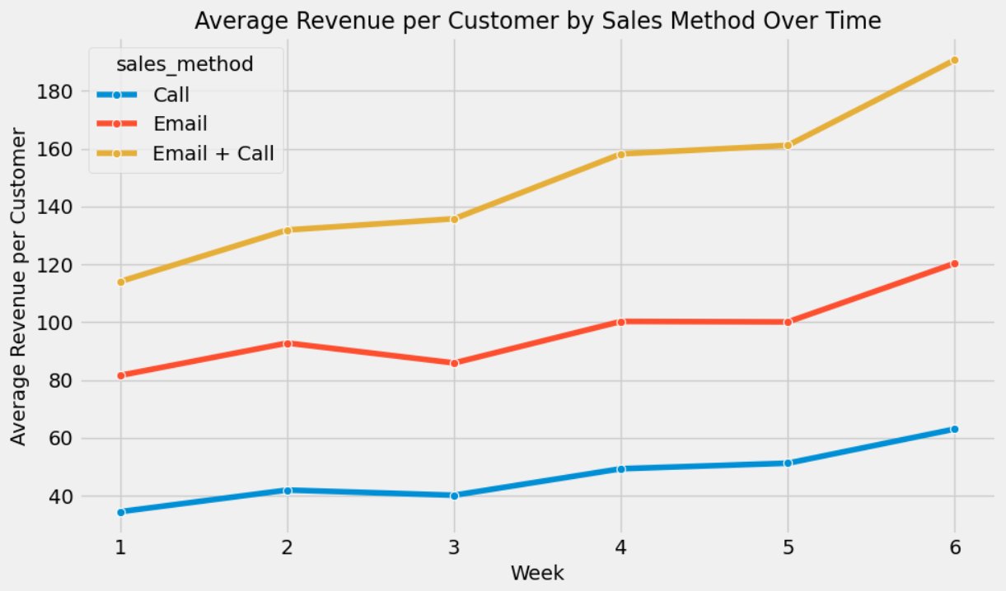
Metric: Average Revenue per Customer per Sales Effort (ARCPSE) 📌 Why It Matters?
Measures efficiency of sales efforts.
Balances revenue generation and effort required. 📌 Current Values:
Email: 0.12
Call: 0.18
Email + Call: 0.15

Slide 8
RECOMMENDATIONS
ACTION PLAN
Prioritize Calls for High-Value Customers: Calls generate more revenue per effort. Leverage Email for Broad Outreach: Lower effort but still drives sales. Use Email + Call for Targeted Follow-ups: Maximize revenue for engaged leads. Monitor ARCPSE Regularly: Ensure sales methods align with revenue goals.

